Slide 1
Sentiment Analysis On Twitter Data
(Using NLP)

Slide 2

What’s Twitter
@twitter
Twitter is an online social networking service that enables users to send and read short 280-character messages called "tweets“
Uses can read and post tweets from their account using from the Twitter website or the app
Tweets can contain words, photos, videos, links and polls
@ sign is used to call out usernames in tweets
Any word or phrase immediately preceded by the # symbol is called the hashtag. By clicking a hashtag, you can see other tweets containing the same keyword or topic
People can follow other accounts they find interesting to view their tweets

Slide 3
About Dataset
Context
This is the sentiment140 dataset. It contains 1,600,000 tweets extracted using the twitter api . The tweets have been annotated (0 = negative, 4 = positive) and they can be used to detect sentiment .
Content
It contains the following 6 fields:
target: the polarity of the tweet (0 = negative, 2 = neutral, 4 = positive)
ids: The id of the tweet ( 2087)
date: the date of the tweet (Sat May 16 23:58:44 UTC 2009)
flag: The query (lyx). If there is no query, then this value is NO_QUERY.
user: the user that tweeted (robotickilldozr)
text: the text of the tweet (Lyx is cool)
Acknowledgements
The official link regarding the dataset with resources about how it was generated is here The official paper detailing the approach is here
Citation: Go, A., Bhayani, R. and Huang, L., 2009. Twitter sentiment classification using distant supervision. CS224N Project Report, Stanford, 1(2009), p.12.

Slide 4
Introduction:
In this assignment,The Sentiment140 dataset is chosen to perform the potential NLP tasks.
Dataset Chosen : Sentiment140 - It consists of a large collection of tweets from the social media platform Twitter. Each tweet in the dataset is labeled with sentiment polarity, indicating whether the tweet expresses a positive, negative, or neutral sentiment.
Information about the dataset:
0 - the polarity of the tweet (0 = negative, 2 = neutral, 4 = positive)
1 - the id of the tweet (2087)
2 - the date of the tweet (Sat May 16 23:58:44 UTC 2009)
3 - the query (lyx). If there is no query, then this value is NO_QUERY.
4 - the user that tweeted (robotickilldozr)
5 - the text of the tweet (Lyx is cool)

Slide 5
Data Preprocessing
The Preprocessing steps taken are:
Lower Casing: Each text is converted to lowercase.
Replacing URLs: Links starting with 'http' or 'https' or 'www' are replaced by ‘’.
Replacing Usernames: Replace @Usernames with word ''. [eg: '@Kaggle' to ‘’].
Replacing Emojis: Replace emojis by using a regex expression. [eg: ':)' to ‘’]
Replacing Contractions: Replacing contractions with their meanings. [eg: "can't" to 'can not’]
Removing Non-Alphabets/puncutations: Replacing characters except Digits, Alphabets and pre-defined Symbols with a space.
Removing stopwords

Slide 6
Data Preprocessing
The Preprocessing steps taken are:
Lower Casing: Each text is converted to lowercase.
Replacing URLs: Links starting with 'http' or 'https' or 'www' are replaced by ‘’.
Replacing Usernames: Replace @Usernames with word ''. [eg: '@Kaggle' to ‘’].
Replacing Emojis: Replace emojis by using a regex expression. [eg: ':)' to ‘’]
Replacing Contractions: Replacing contractions with their meanings. [eg: "can't" to 'can not’]
Removing Non-Alphabets/puncutations: Replacing characters except Digits, Alphabets and pre-defined Symbols with a space.
Removing stopwords

Slide 7
We have used two model to classify the text data:
Logistic Regression:
Logistic Regression is a statistical method used for binary classification problems, where the outcome variable is categorical and has two classes. Despite its name, logistic regression is a classification algorithm, not a regression algorithm. It's commonly used in machine learning for tasks such as spam detection, medical diagnosis, and credit scoring.
XGBoostClassifier: XGBoost (Extreme Gradient Boosting) is a popular and powerful machine learning algorithm that belongs to the family of gradient boosting algorithms. XGBoost is known for its efficiency, speed, and high performance in various machine learning tasks, particularly in structured/tabular data problems.

Slide 8
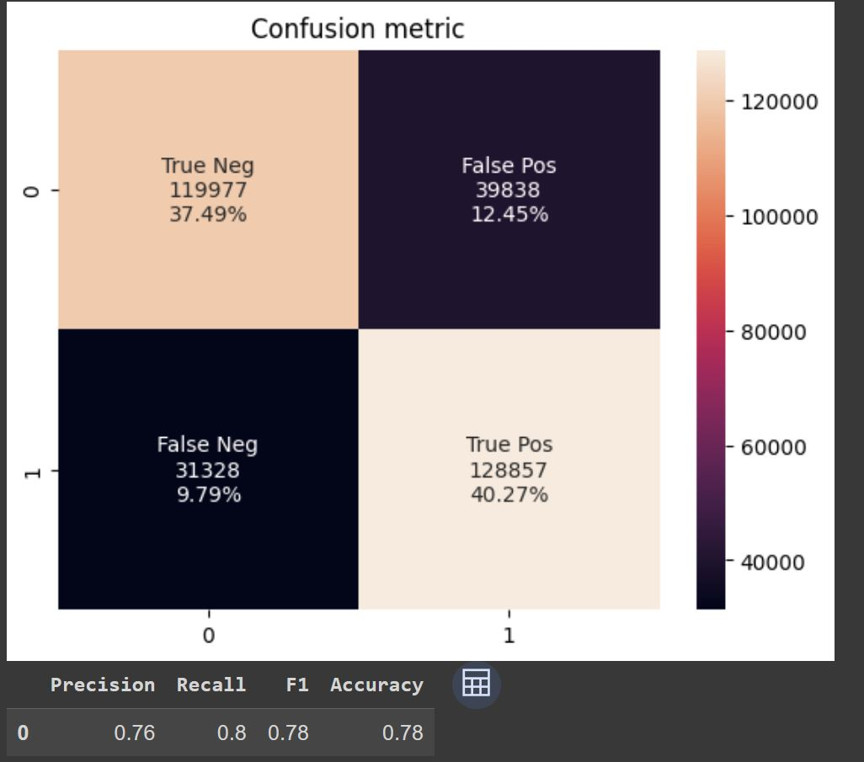
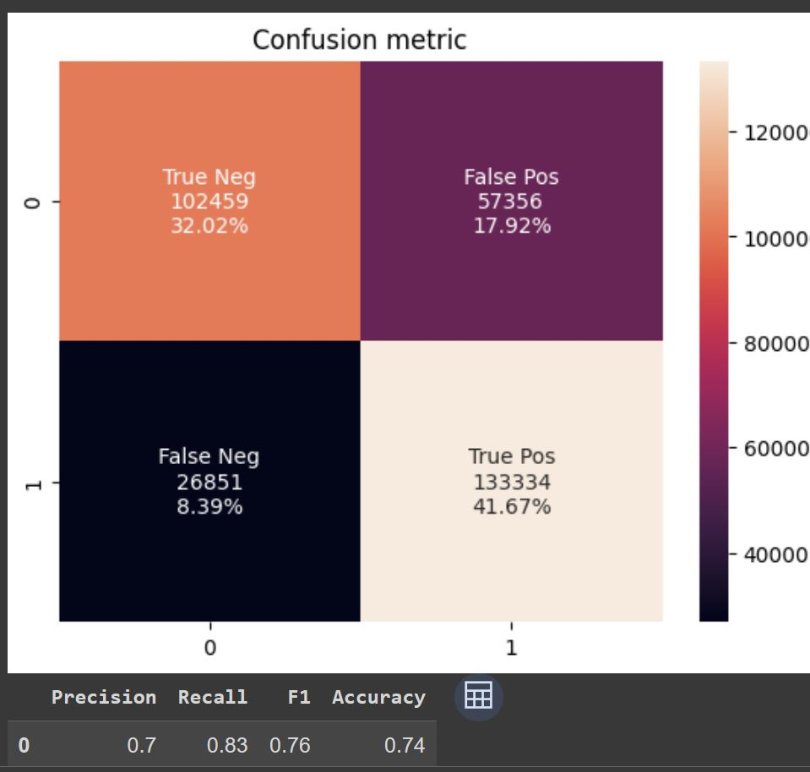
Logistic Regression
XGBoostClassifier
@comparison
@comparison
10:10 PM
11:16PM

Slide 9
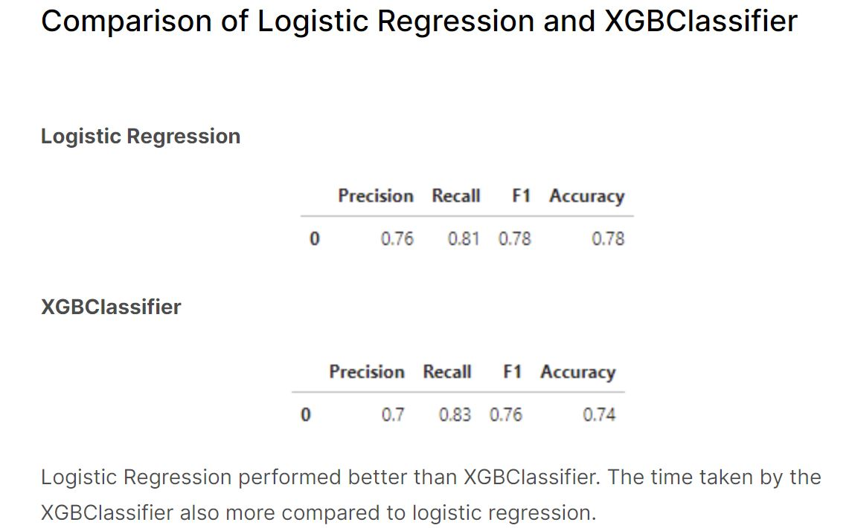

Slide 10
Thanks

